Slide 1
LOWER SIXTH ARTS
GEOGRAPHY
Lesson 14
Tourism Development in Cameroon
Notes:
Good morning, class, and welcome to our geography lesson. I am your geography teacher, Mr Kamdem. Today we are starting Lesson 14: Tourism Development in Cameroon.

Slide 2
CLASS INFO
Class, Chapter and Duration
Class | Lower Sixth Arts
Chapter | Geography of Cameroon
Duration | 2 periods (2 × 50 minutes)
Notes:
This lesson is for Lower Sixth Arts. It belongs to Geography of Cameroon. We shall need 2 periods to cover it.

Slide 3
IDENTIFICATION
Lesson Identification
Topic | Geography of Cameroon
Sub-topic | Economic Activities and Development of Cameroon
Lesson | Lesson 14: Tourism Development in Cameroon
Notions / Concepts | Tourism, tourist resource, tourist infrastructure, destination, ecotourism, cultural tourism.
Syllabus focus | Tourism resources (natural and human) and their distribution and exploitation; tourism infrastructure; sources of tourists and prime destinations; problems; measures to promote tourism; impacts on the economy, communities and environment.
Competence | Learners are able to describe the tourist resources of Cameroon, explain the problems of tourism and propose measures to promote it.
Notes:
Our topic is Geography of Cameroon, and the sub-topic is Economic Activities and Development of Cameroon. The key notions we shall use today are: tourism, tourist resource, tourist infrastructure, destination, ecotourism, cultural tourism. At the end, you should be able to do this: learners are able to describe the tourist resources of Cameroon, explain the problems of tourism and propose measures to promote it.

Slide 4

HOMEWORK CORRECTION
Correction of the Homework
Question (Lesson 13: Transport Development in Cameroon):
Name two national parks of the North Region.
Notes:
Before we start the new lesson, let us correct the homework I gave you at the end of Lesson 13: Transport Development in Cameroon. The question was: Name two national parks of the North Region. Take out your exercise books.

Slide 5
HOMEWORK CORRECTION
Correction: Possible Answer
The Bénoué, Bouba Ndjida and Faro National Parks.
Notes:
Here is a good answer. The Bénoué, Bouba Ndjida and Faro National Parks. Compare it with your own answer and correct your work in red.

Slide 6
LESSON PLAN
Lesson Plan
Correction of the homework
Objectives and recall
Real-life situation and action to take
Learning activities
Board summary
Evaluation, remediation and homework
Notes:
Here is the plan of our lesson today. First, we shall correct the homework. Then we shall look at the objectives and recall what you already know. After that, we shall study a situation from real life and the action to take, and do the learning activities. Finally, we shall copy the board summary, do the evaluation and the remediation, and I will give you the homework.

Slide 7
OBJECTIVES
Objectives
By the end of this lesson, you should be able to:
Describe the natural and human tourism resources of Cameroon.
Describe the tourism infrastructure, sources of tourists and destinations.
Notes:
Take your time to copy this part; we will continue together.

Slide 8
OBJECTIVES
Objectives (continued)
Explain the problems hindering tourism and the measures to promote it.
Assess the impacts of tourism.
Notes:
By the end of this lesson, you should be able to do four things. Number 1: describe the natural and human tourism resources of Cameroon. Number 2: describe the tourism infrastructure, sources of tourists and destinations. Number 3: explain the problems hindering tourism and the measures to promote it. Number 4: assess the impacts of tourism.

Slide 9
PREVIOUS KNOWLEDGE
Previous Knowledge
Cameroon is called "Africa in miniature".
The Bénoué National Park is near Garoua.
Mount Cameroon is the highest mountain of Cameroon.
Notes:
Let us first remember what you already know. Cameroon is called "Africa in miniature". The Bénoué National Park is near Garoua. Mount Cameroon is the highest mountain of Cameroon. Keep this in mind, because we shall build on it today.

Slide 10
REAL-LIFE SITUATION
Situation in Real Life
French tourists arrive at Garoua airport for a safari in the Bénoué National Park.
Their guide Oumarou is worried: the road to the park is damaged, and good hotels with electricity and internet are hard to find near the park.
Notes:
Take your time to copy this part; we will continue together.

Slide 11
REAL-LIFE SITUATION
Situation in Real Life (continued)
The tourists are delighted by the elephants and hippos but find few services.
Oumarou asks: "How can Cameroon, so rich in attractions, receive more tourists and benefit more from them?"
Notes:
Listen carefully to this situation from real life. French tourists arrive at Garoua airport for a safari in the Bénoué National Park. Their guide Oumarou is worried: the road to the park is damaged, and good hotels with electricity and internet are hard to find near the park. The tourists are delighted by the elephants and hippos but find few services. Oumarou asks: "How can Cameroon, so rich in attractions, receive more tourists and benefit more from them?" Think about it, because I am going to ask you some questions.

Slide 12
REAL-LIFE SITUATION
Situation: Question 1
What is the problem in the situation?
Notes:
Question 1: What is the problem in the situation? Think for a moment, then raise your hand to answer.

Slide 13
REAL-LIFE SITUATION
Answer
Cameroon has rich attractions, but poor infrastructure limits tourism.
Notes:
Good. Cameroon has rich attractions, but poor infrastructure limits tourism.

Slide 14
REAL-LIFE SITUATION
Situation: Question 2
What attracted the tourists?
Notes:
Question 2: What attracted the tourists? Think for a moment, then raise your hand to answer.

Slide 15
REAL-LIFE SITUATION
Answer
The wildlife of the Bénoué National Park (elephants, hippos).
Notes:
Good. The wildlife of the Bénoué National Park (elephants, hippos).

Slide 16
REAL-LIFE SITUATION
Situation: Question 3
What worries the guide?
Notes:
Question 3: What worries the guide? Think for a moment, then raise your hand to answer.

Slide 17
REAL-LIFE SITUATION
Possible Answer
The damaged road and the lack of good hotels.
Notes:
Good. The damaged road and the lack of good hotels.

Slide 18
ACTION TO TAKE
Action to Take
Welcome visitors, protect tourist sites and value our cultures.
Notes:
From this situation, the action we are working towards in this lesson is the following: welcome visitors, protect tourist sites and value our cultures.

Slide 19
JUSTIFICATION
Justification of the Lesson
This lesson helps us to know the tourist wealth of Cameroon and the conditions for developing tourism.
Notes:
Why is this lesson important for you? This lesson helps us to know the tourist wealth of Cameroon and the conditions for developing tourism.

Slide 20
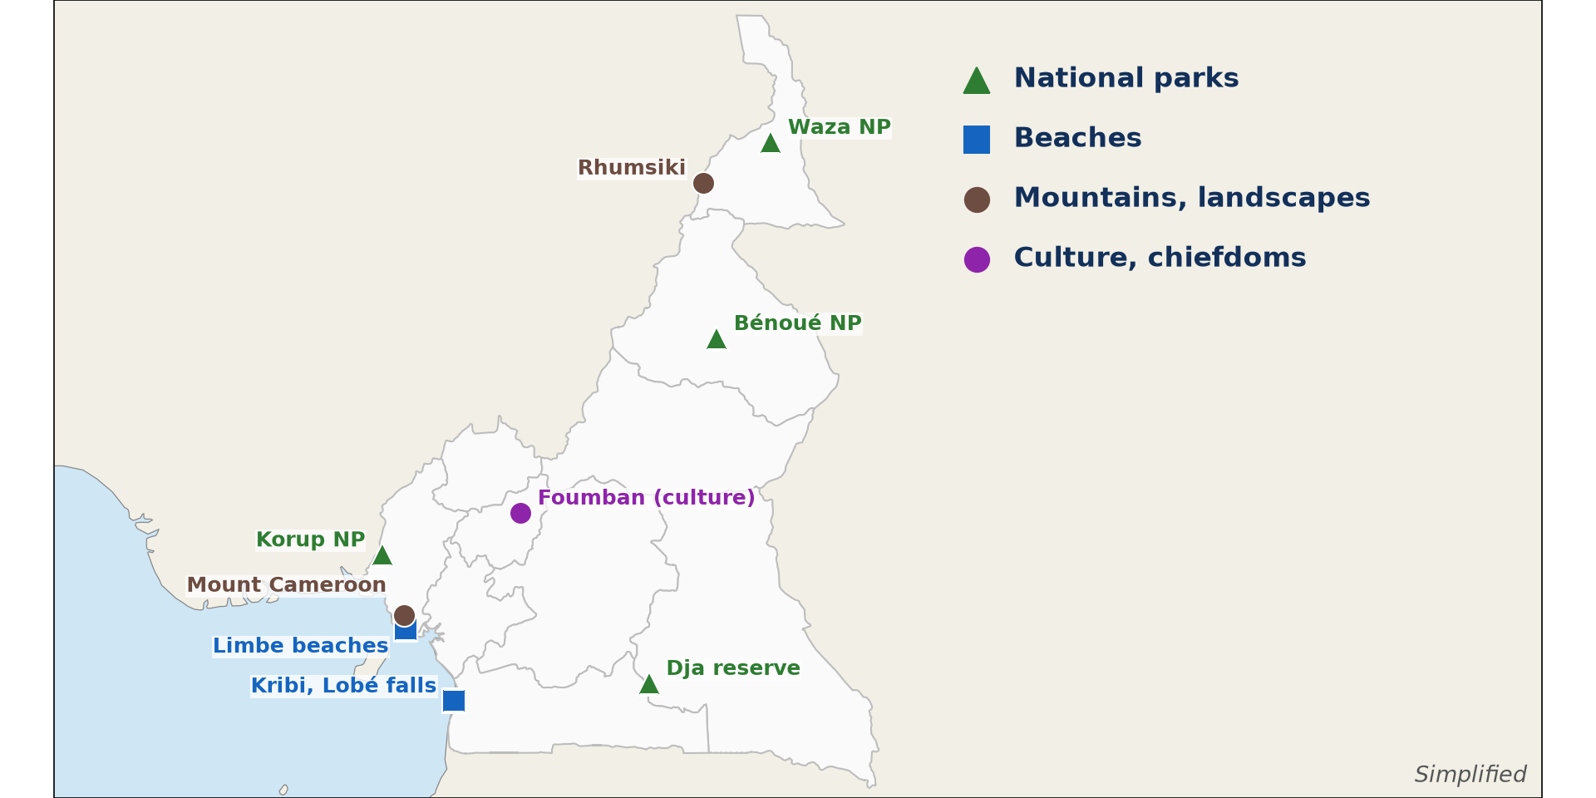
1. TOURISM RESOURCES
Activity 1
Tourist sites of Cameroon.
Notes:
Activity 1. Look carefully at this diagram: tourist sites of Cameroon. Observe every detail before I ask the question.

Slide 21
1. TOURISM RESOURCES
Activity 1: Question
Name one national park of the Far North.
Notes:
Here is the question for Activity 1: Name one national park of the Far North. Take one minute to think and write your answer in your rough notebook.

Slide 22
1. TOURISM RESOURCES
Activity 1: Answer
The Waza National Park.
Notes:
Let us check the answer together. The Waza National Park.

Slide 23

1. TOURISM RESOURCES
Activity 2
Mountains of the Far North.
Notes:
Activity 2. Look carefully at this picture: mountains of the Far North. Observe every detail before I ask the question.

Slide 24
1. TOURISM RESOURCES
Activity 2: Question
Why do tourists visit Rhumsiki?
Notes:
Here is the question for Activity 2: Why do tourists visit Rhumsiki? Take one minute to think and write your answer in your rough notebook.

Slide 25
1. TOURISM RESOURCES
Activity 2: Answer
For its volcanic peaks and landscapes in the Mandara Mountains.
Notes:
Let us check the answer together. For its volcanic peaks and landscapes in the Mandara Mountains.

Slide 26

1. TOURISM RESOURCES
Activity 3
A traditional chiefdom.
Notes:
Activity 3. Look carefully at this picture: a traditional chiefdom. Observe every detail before I ask the question.

Slide 27
1. TOURISM RESOURCES
Activity 3: Question
Which kind of tourism does this chiefdom attract?
Notes:
Here is the question for Activity 3: Which kind of tourism does this chiefdom attract? Take one minute to think and write your answer in your rough notebook.

Slide 28
1. TOURISM RESOURCES
Activity 3: Answer
Cultural tourism.
Notes:
Let us check the answer together. Cultural tourism.

Slide 29
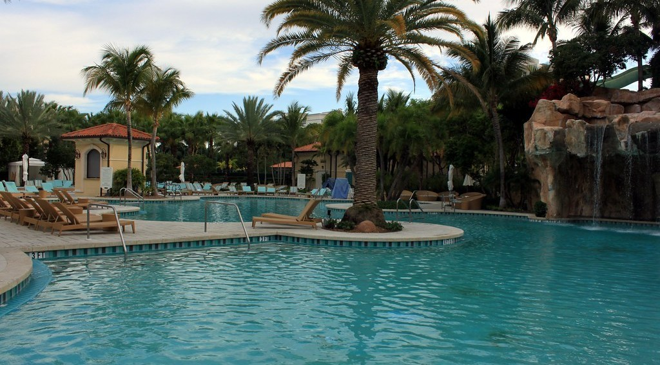
2. INFRASTRUCTURE AND DESTINATIONS
Activity 4
A hotel.
Notes:
Activity 4. Look carefully at this picture: a hotel. Observe every detail before I ask the question.

Slide 30
2. INFRASTRUCTURE AND DESTINATIONS
Activity 4: Question
Why are hotels important for tourism?
Notes:
Here is the question for Activity 4: Why are hotels important for tourism? Take one minute to think and write your answer in your rough notebook.

Slide 31
2. INFRASTRUCTURE AND DESTINATIONS
Activity 4: Answer
Tourists need safe, comfortable accommodation near the sites.
Notes:
Let us check the answer together. Tourists need safe, comfortable accommodation near the sites.

Slide 32

3. PROBLEMS
Activity 5
A damaged road.
Notes:
Activity 5. Look carefully at this picture: a damaged road. Observe every detail before I ask the question.

Slide 33
3. PROBLEMS
Activity 5: Question
Give one problem that limits tourism in Cameroon.
Notes:
Here is the question for Activity 5: Give one problem that limits tourism in Cameroon. Take one minute to think and write your answer in your rough notebook.

Slide 34
3. PROBLEMS
Activity 5: Answer
Bad roads (also insecurity and poor marketing).
Notes:
Let us check the answer together. Bad roads (also insecurity and poor marketing).

Slide 35
BOARD SUMMARY
Board Summary
Topic: Geography of Cameroon
Sub-topic: Economic Activities and Development of Cameroon
Lesson 14: Tourism Development in Cameroon
Notes:
Now we are going to copy the board summary. Write the title and the headings neatly in your notebooks. I will give you enough time for each slide, so do not rush.

Slide 36
BOARD SUMMARY
DEFINITIONS
The key terms of this lesson are defined as follows:
Tourism: It is travelling to and staying in places outside one's usual environment for leisure, business or other purposes.
Tourist resource: It is a natural or human feature that attracts visitors.
Notes:
Let us copy the definitions. The key terms of this lesson are defined as follows. On this slide we have Tourism and Tourist resource. Write each point on a new line, with the key term first, and explain it in your own words when we revise. When you finish, we go to the next slide.

Slide 37
BOARD SUMMARY
DEFINITIONS (continued)
Tourism infrastructure: It is the set of facilities that serve tourists: roads, airports, hotels, restaurants and guides.
Ecotourism: It is tourism in natural areas that protects the environment and benefits local people.
Notes:
We continue with the definitions. On this slide we have Tourism infrastructure and Ecotourism. Write each point on a new line, with the key term first, and explain it in your own words when we revise.

Slide 38
BOARD SUMMARY
1. Tourism Resources
A) Natural Resources
The natural tourism resources of Cameroon and their distribution are the following:
Wildlife parks: Waza (Far North), Bénoué, Bouba Ndjida and Faro (North), Korup (South-West), Dja and Lobéké (forest zone).
Illustration: tourist sites of Cameroon
Notes:
Let us copy Natural Resources. The natural tourism resources of Cameroon and their distribution are the following. Copy the point on Wildlife parks on the left, then draw the diagram on the right: tourist sites of Cameroon. Give it a title and label it clearly.

Slide 39
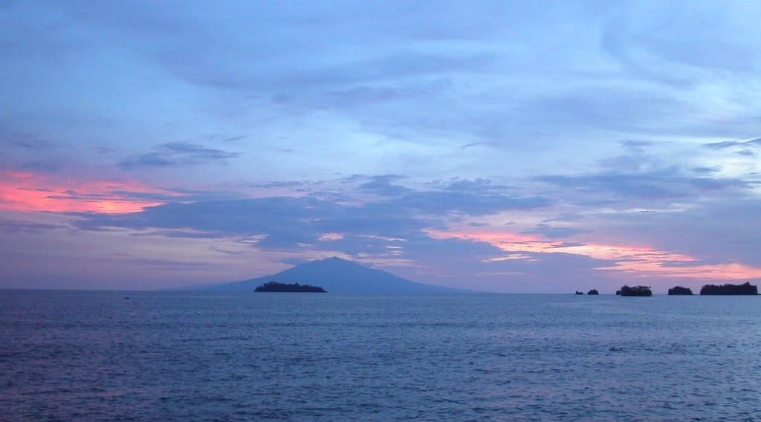
BOARD SUMMARY
1. Tourism Resources
A) Natural Resources
Beaches and coasts: Kribi, with the Lobé Falls that fall into the sea, and Limbe, with black volcanic sand and a botanical garden.
Illustration: the coast at Limbe
Notes:
Copy the point on Beaches and coasts on the left, then draw the diagram on the right: the coast at Limbe. Give it a title and label it clearly.

Slide 40
BOARD SUMMARY
1. Tourism Resources
A) Natural Resources
Mountains and landscapes: Mount Cameroon (Race of Hope), the Mandara Mountains (Rhumsiki), the Bamenda Highlands (Ring Road) and the Adamawa.
Illustration: the Mandara Mountains
Notes:
Copy the point on Mountains and landscapes on the left, then draw the diagram on the right: the Mandara Mountains. Give it a title and label it clearly.

Slide 41
BOARD SUMMARY
1. Tourism Resources
A) Natural Resources
Lakes and waterfalls: Crater lakes (Barombi Mbo, Nyos, Ossa), the Ekom-Nkam and Menchum Falls and the Lagdo lake.
Level of exploitation: Most sites are little exploited because of poor access and few services.
Notes:
We continue with Natural Resources. On this slide we have Lakes and waterfalls and Level of exploitation. Write each point on a new line, with the key term first, and explain it in your own words when we revise.

Slide 42
BOARD SUMMARY
1. Tourism Resources
B) Human (Cultural) Resources
The human tourism resources of Cameroon are the following:
Traditional palaces: The Sultan's palace of Foumban, the palaces of the Fons (Bafut) and the lamidats of the north (Garoua, Rey Bouba).
Illustration: a traditional chiefdom
Notes:
Let us copy Human (Cultural) Resources. The human tourism resources of Cameroon are the following. Copy the point on Traditional palaces on the left, then draw the diagram on the right: a traditional chiefdom. Give it a title and label it clearly.

Slide 43
BOARD SUMMARY
1. Tourism Resources
B) Human (Cultural) Resources
Festivals: The Ngondo of the Sawa (Douala), the Nguon of the Bamoun (Foumban) and the Lela of Bali.
Historical sites: The slave-trade site of Bimbia, German colonial buildings in Buea and other towns.
Notes:
We continue with Human (Cultural) Resources. On this slide we have Festivals and Historical sites. Write each point on a new line, with the key term first, and explain it in your own words when we revise. When you finish, we go to the next slide.

Slide 44
BOARD SUMMARY
1. Tourism Resources
B) Human (Cultural) Resources (continued)
Crafts and cultures: Over 250 ethnic groups, with crafts, music, dances and cuisine.
Notes:
We continue with Human (Cultural) Resources. On this slide we have Crafts and cultures. Write each point on a new line, with the key term first, and explain it in your own words when we revise.

Slide 45
BOARD SUMMARY
2. Tourism Infrastructure, Sources and Destinations
Tourism infrastructure, sources of tourists and destinations are the following:
Infrastructure: International airports (Douala, Yaoundé, Garoua), hotels concentrated in large towns and a few lodges near parks.
Illustration: a hotel
Notes:
Let us copy Tourism Infrastructure, Sources and Destinations. Tourism infrastructure, sources of tourists and destinations are the following. Copy the point on Infrastructure on the left, then draw the diagram on the right: a hotel. Give it a title and label it clearly.

Slide 46
BOARD SUMMARY
2. Tourism Infrastructure, Sources and Destinations
Organs: The Ministry of Tourism and Leisure (MINTOUL) and regional and local councils promote tourism.
Sources of tourists: Mainly Europe (especially France), neighbouring African countries (Nigeria, Chad, Gabon) and North America.
Notes:
We continue with Tourism Infrastructure, Sources and Destinations. On this slide we have Organs and Sources of tourists. Write each point on a new line, with the key term first, and explain it in your own words when we revise. When you finish, we go to the next slide.

Slide 47
BOARD SUMMARY
2. Tourism Infrastructure, Sources and Destinations (continued)
Prime destinations: Kribi, Limbe and Buea, the Western Highlands, Waza and the northern parks, and Foumban.
Notes:
We continue with Tourism Infrastructure, Sources and Destinations. On this slide we have Prime destinations. Write each point on a new line, with the key term first, and explain it in your own words when we revise.

Slide 48
BOARD SUMMARY
3. Problems Hindering Tourism
Tourism is hindered by the following problems:
Poor access: Bad roads and few flights to tourist sites.
Illustration: a damaged road
Notes:
Let us copy Problems Hindering Tourism. Tourism is hindered by the following problems. Copy the point on Poor access on the left, then draw the diagram on the right: a damaged road. Give it a title and label it clearly.

Slide 49
BOARD SUMMARY
3. Problems Hindering Tourism
Insecurity: Boko Haram in the Far North and the crisis in the North-West and South-West have closed some sites.
Few services: Few good hotels, guides and restaurants outside large towns.
Poor promotion: Cameroon is little known on the international market.
Notes:
We continue with Problems Hindering Tourism. On this slide we have Insecurity, Few services and Poor promotion. Write each point on a new line, with the key term first, and explain it in your own words when we revise. When you finish, we go to the next slide.

Slide 50
BOARD SUMMARY
3. Problems Hindering Tourism (continued)
Poaching and degradation: Poaching and bush fires reduce wildlife in parks.
Notes:
We continue with Problems Hindering Tourism. On this slide we have Poaching and degradation. Write each point on a new line, with the key term first, and explain it in your own words when we revise.

Slide 51
BOARD SUMMARY
4. Measures to Promote Tourism
Tourism can be promoted by the following measures:
By the government: Improve security, roads and airports, train staff, promote "Destination Cameroon" and protect parks.
Notes:
Let us copy Measures to Promote Tourism. Tourism can be promoted by the following measures. On this slide we have By the government. Write each point on a new line, with the key term first, and explain it in your own words when we revise. When you finish, we go to the next slide.

Slide 52
BOARD SUMMARY
4. Measures to Promote Tourism (continued)
By communities: Develop community-based tourism (village stays, cultural festivals, crafts) and protect sites.
By individuals: Guides, hotel owners and drivers offer good, honest services.
Notes:
We continue with Measures to Promote Tourism. On this slide we have By communities and By individuals. Write each point on a new line, with the key term first, and explain it in your own words when we revise.

Slide 53
BOARD SUMMARY
5. Impacts of Tourism
Tourism has the following impacts:
On the economy: Foreign currency, jobs (guides, hotels, transport) and markets for crafts; but dependence on an unstable activity.
Notes:
Let us copy Impacts of Tourism. Tourism has the following impacts. On this slide we have On the economy. Write each point on a new line, with the key term first, and explain it in your own words when we revise. When you finish, we go to the next slide.

Slide 54
BOARD SUMMARY
5. Impacts of Tourism (continued)
On local communities: Income and pride in local culture; but rising prices and loss of the meaning of some traditions.
On the environment: Money for conservation (ecotourism); but pollution, waste and disturbance of wildlife.
Notes:
We continue with Impacts of Tourism. On this slide we have On local communities and On the environment. Write each point on a new line, with the key term first, and explain it in your own words when we revise.

Slide 55
FORMATIVE EVALUATION
Evaluation 1
Give two natural and two human tourism resources of Cameroon.
Notes:
Now let us check what you have understood. Question 1: Give two natural and two human tourism resources of Cameroon. Answer in your exercise book.

Slide 56
FORMATIVE EVALUATION
Expected Answer
Waza National Park and the beaches of Kribi; the Foumban palace and the Ngondo festival.
Notes:
The expected answer is: waza National Park and the beaches of Kribi; the Foumban palace and the Ngondo festival. If you got it right, well done.

Slide 57
FORMATIVE EVALUATION
Evaluation 2
Give two problems of tourism and one measure to promote it.
Notes:
Now let us check what you have understood. Question 2: Give two problems of tourism and one measure to promote it. Answer in your exercise book.

Slide 58
FORMATIVE EVALUATION
Expected Answer
Bad roads and insecurity; improving security (or roads).
Notes:
The expected answer is: bad roads and insecurity; improving security (or roads). If you got it right, well done.

Slide 59
REMEDIATION
Remediation
Fill in the blanks:
The ministry in charge of tourism is ______.
The festival of the Sawa people in Douala is the ______.
Notes:
Take your time to copy this part; we will continue together.

Slide 60
REMEDIATION
Remediation (continued)
The waterfall of Kribi that falls into the sea is the ______ Falls.
Notes:
For those who need more practice, fill in the blanks in your exercise book. The answers are: number 1, MINTOUL; number 2, Ngondo; number 3, Lobé.

Slide 61
HOMEWORK
Homework
Name one region of Cameroon that is more developed and one that is less developed.
Notes:
For your homework: Name one region of Cameroon that is more developed and one that is less developed. We shall correct it at the beginning of our next lesson.

Slide 62
NEXT LESSON
Next Lesson
Our next lesson will be on:
Lesson 15: Contrasts in Development within Cameroon
Notes:
Our next lesson will be on Lesson 15: Contrasts in Development within Cameroon. Thank you for your attention, and see you next time.

Slide 63
BILINGUAL GAME
Bilingual Game (Jeu Bilingue)
English | Français
Tourism | Le tourisme
Tourist | Le touriste
Hotel | L'hôtel
National park | Le parc national
Festival | Le festival
Guide | Le guide
Beach | La plage
Crafts | L'artisanat
Notes:
Let us play the bilingual game. I say a word in English, and you give me the French word. Then we do the reverse.

Slide 64
LOGBOOK
Official Logbook (1/2)
Module / Topic | Geography of Cameroon
Lesson Title | Lesson 14: Tourism Development in Cameroon
Expected Learning Outcomes | Describe the natural and human tourism resources of Cameroon. Describe the tourism infrastructure, sources of tourists and destinations. Explain the problems hindering tourism and the measures to promote it. Assess the impacts of tourism.
Competence | Learners are able to describe the tourist resources of Cameroon, explain the problems of tourism and propose measures to promote it.
Notes:
I record this information in the official logbook of the class after the lesson.

Slide 65
LOGBOOK
Official Logbook (2/2)
Matter Taught | DEFINITIONS; Natural Resources; Human (Cultural) Resources; Tourism Infrastructure, Sources and Destinations; Problems Hindering Tourism; Measures to Promote Tourism; Impacts of Tourism.
Evaluation | Formative evaluation and remediation exercise.
Homework | Name one region of Cameroon that is more developed and one that is less developed.
Enrolment / Present / Absent | ____ / ____ / ____
Achievement | To be completed after the lesson.
Notes:
I complete the second page of the logbook: the matter taught, the evaluation, the homework and the attendance.

Slide 66
TEACHER'S NOTE
Teacher's Note
Timing: Homework correction, plan, objectives 8 min | Recall, situation, action 10 min | 5 activities 30 min | Board summary (copying) 30 min | Evaluation, remediation 10 min | Homework, next lesson 5 min | Logbook 7 min
Without the projector (Activity 1): mark tourist sites on a sketch map.
Without the projector (Activity 2): describe the Mandara landscapes.
Without the projector (Activity 3): name palaces and festivals.
Without the projector (Activity 4): list hotels of Garoua.
Without the projector (Activity 5): discuss the road to the Bénoué park.
Notes:
This slide is for me, the teacher: it gives the timing of the lesson and what to do if the projector is not available.

Slide 67
REFERENCES
References
Geography Syllabus for Sixth Forms (Lower and Upper Sixth), MINESEC, 2019 — Geography of Cameroon.
Teacher's course notes: Mr KAMDEM E., Cameroon Geography (LSA and USA), GBHS Garoua, 2026.
INS, Fourth Cameroon Household Survey (ECAM 4), 2014.
Photo, Activity 2: “Rhumsiki peak, North Cameroon” by krishna.naudin, CC BY-SA 2.0, via Flickr (https://www.flickr.com/photos/141297921@N05/25989204581)
Photo, Activity 3: “Bandjoun's chefferie: I - the approach past the royal quarters” by 10b travelling / Carsten ten Brink, CC BY-NC-ND 2.0, via Flickr (https://www.flickr.com/photos/77334245@N00/7326237514)
Photo, Activity 4: “Laguna Pool” by Prayitno / Thank you for (12 millions +) view, CC BY 2.0, via Flickr (https://www.flickr.com/photos/34128007@N04/14216582552)
Photo, Activity 5: “Cameroon - UN Women's Gender Road Project” by UN Women Gallery, CC BY-NC-ND 2.0, via Flickr (https://www.flickr.com/photos/51431730@N04/40672356003)
Notes:
Take your time to copy this part; we will continue together.

Slide 68
REFERENCES
References (continued)
Photo, board summary (Beaches and coasts): “Sunset in Limbe” by visulogik, CC BY 2.0, via Flickr (https://www.flickr.com/photos/55671677@N00/2202334428)
Diagrams and animations: drawn for this lesson (Geography Department).
Notes:
These are the references and picture credits used to prepare this lesson.

